Slide 1

Documentation management and version control
By – kanaga Manikandan Solaikannan

Slide 2
What are they?
Used to preserve the files in an external storage where it’s secure and accessible by other team members (AIIM n.d.).
Version Control keeps track of all the modifications performed by the team (Atlassian n.d.).
Talking about how they were used.
Notes:
Before 2nd point - One such technique is Version Control. Click
After 2nd point – start afresh if any problems were to rise. There are more benefits in using Version Control and that’s what ‘Click’ for 3rd point

Slide 3

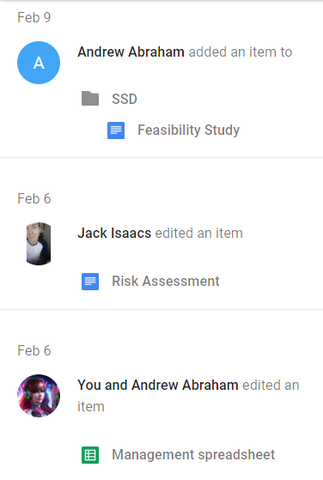
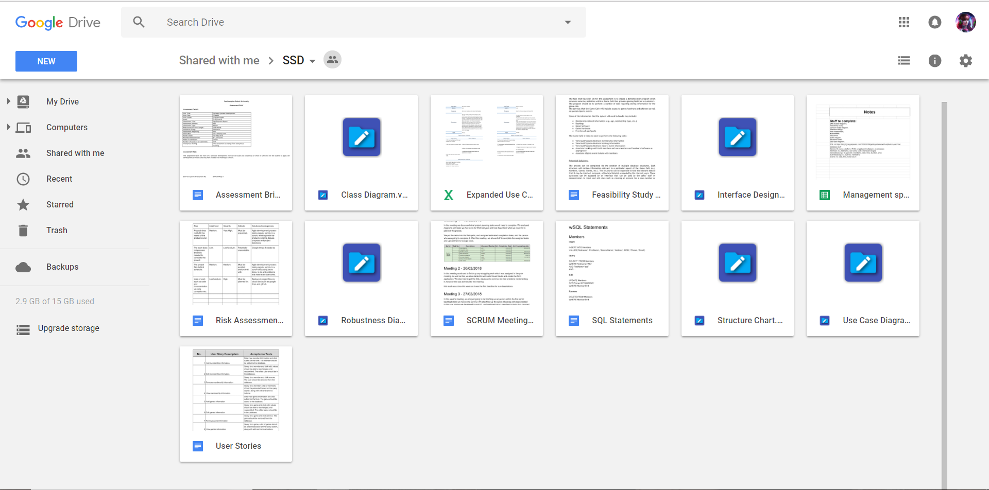
how were the documents managed?
Google Drive was used to securely store the files.
Allowed the team to make any changes to the files freely.
Notifications allowed the team to be up to date with the progress.

Slide 4
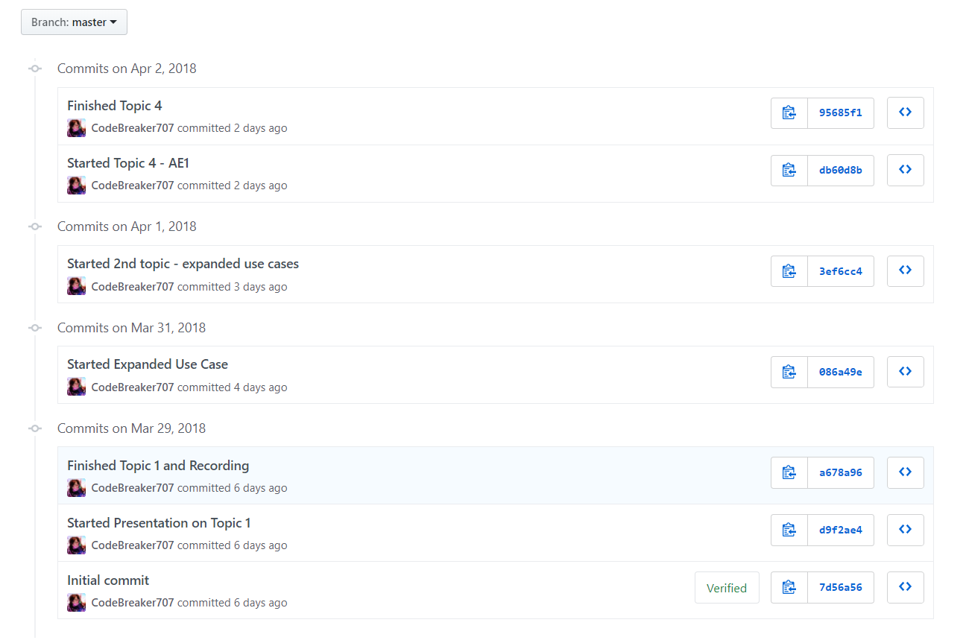
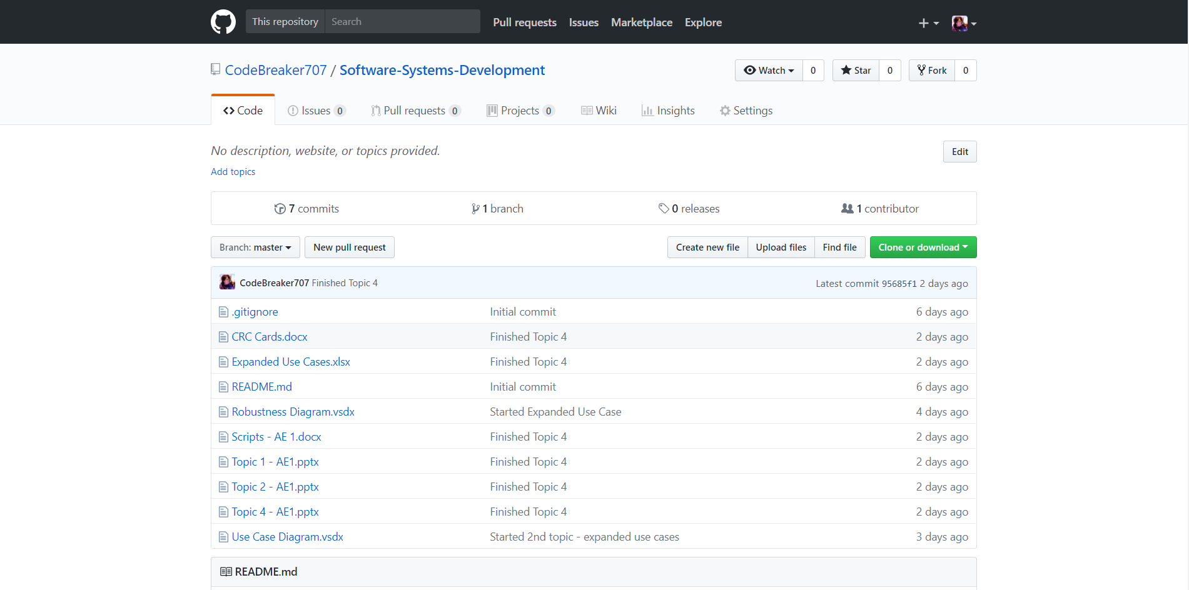
How was version control helpful?
GitHub was also used to securely store the files.
Allowed the team to keep track of all the updates.
Proved better than Google Drive.
Notes:
3rd point – why better at uploading because Google drive cannot not know what changes have you made unless you uploaded them where as in GitHub, you can make any changes in the desktop and it will keep note of all changes and all you had to do was ‘commit changes and push it to the online storage’.

Slide 5
How did it pay off?
Made communication easier and easy to use.
Proved to be reliable and cost-efficient.
Allowed the team to work together on a single document and discuss about it at the same time.

Slide 6
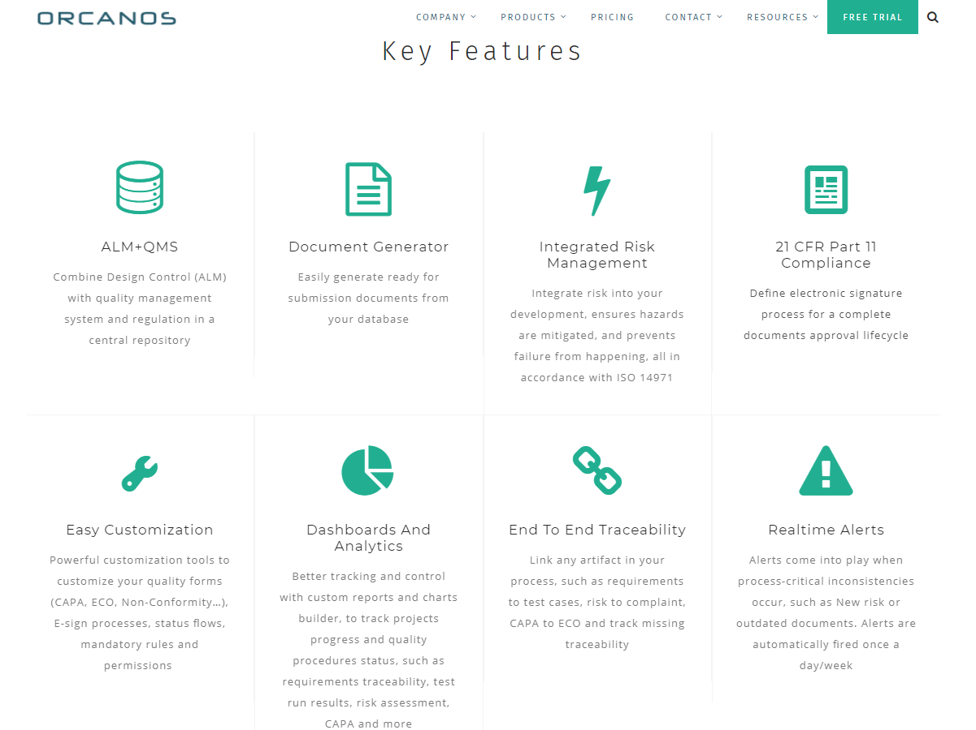
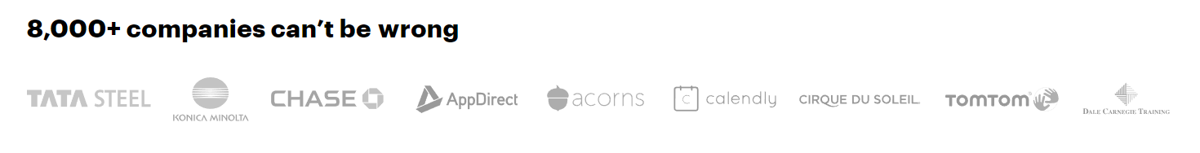
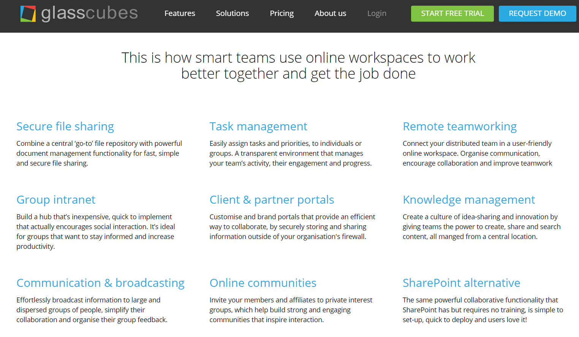
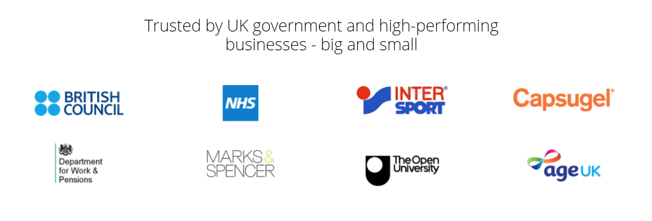
What else can be done?
There are other software products available online that offer more features.
Some of them are Orcanos, Glasscubes and PandaDoc (Orcanos n.d.; GlassCubes n.d.; PandaDoc n.d.).
They even seemed to be used by a lot of prestigious companies.

Slide 7
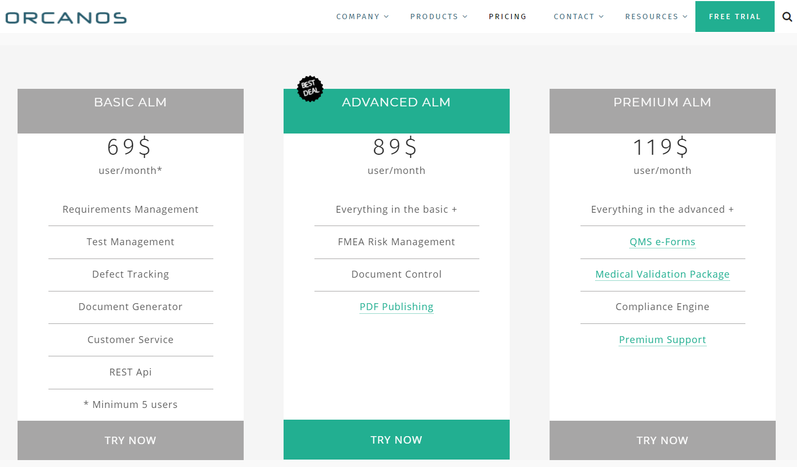
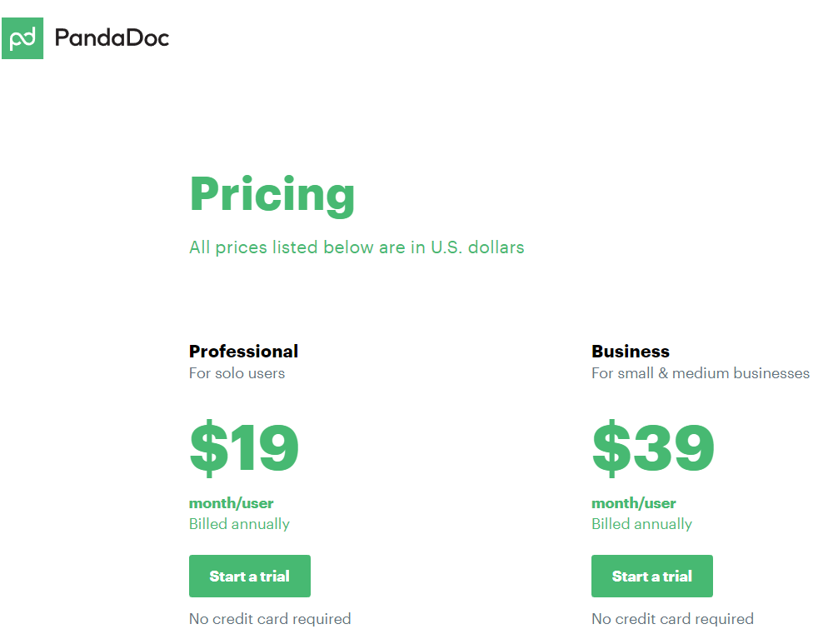
Why were these not chosen?
One of the reasons is that they’re priced by subscriptions (Orcanos n.d.; GlassCubes n.d.; PandaDoc n.d.).
The features they provided weren’t necessary for our project.
The team members could not afford to pay for such services.
Notes:
1st point – Some thought could have been given if they were available with a single payment.
2nd point – It is a team of 3 and the software we’re producing in the end is not large-scale
Thus, the team decided to use software products that were free and provided all the necessary benefits.

Slide 8
references
AIIM, n.d. What is Document Management (DMS) [viewed 11 April 2018]. Available from: http://www.aiim.org/What-Is-Document-Imaging#
ATLASSIAN, n.d. What is version control | Atlassian Git Tutorial [viewed 11 April 2018]. Available from: https://www.atlassian.com/git/tutorials/what-is-version-control#
ORCANOS, n.d. Orcanos Software – ALM and Quality Management [viewed 11 April 2018]. Available from: https://www.orcanos.com/compliance/
PANDADOC, n.d. Features – PandaDoc [viewed 11 April 2018]. Available from: https://www.pandadoc.com/features/
GLASSCUBES, n.d. Secured Online Workspaces for Business | Glasscubes [viewed 11 April 2018]. Available from: https://www.glasscubes.com/
ORCANOS, n.d. Pricing – orcanos [viewed 11 April 2018]. Available from: https://www.orcanos.com/compliance/orcanos-pricing/
PANDADOC, n.d. Pricing – PandaDoc [viewed 11 April 2018]. Available from: https://www.pandadoc.com/pricing/
GLASSCUBES, n.d. Team, Workgroup or Enterprise – Which one’s right for you? [viewed 11 April 2018]. Available from: https://www.glasscubes.com/pricing/

